Slide 1

Site Capacity
Business Requirement Document

Slide 2



Objective
Automation
Visualization
Current process requires 4 hours
No visualization in PowerBI

Slide 3
Current process
Planners will send Change Request Capacity POR
Changes will be updated in Site Cap excel file
(Manual work)
Send out email to respective stakeholders

Slide 4
New process
Planners will send Change Request Capacity POR
Run Program and reporting in PowerBI
Send out email to respective stakeholders
* Automated

Slide 5
Requirements
Monthly snapshot of site capacity by MPa, Family and Product
Automation and data download

Slide 6
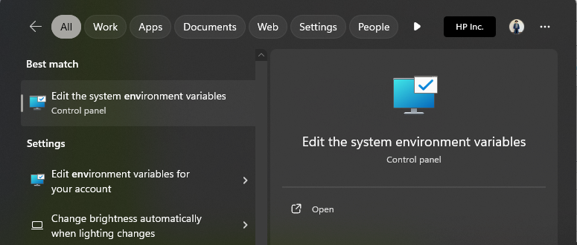
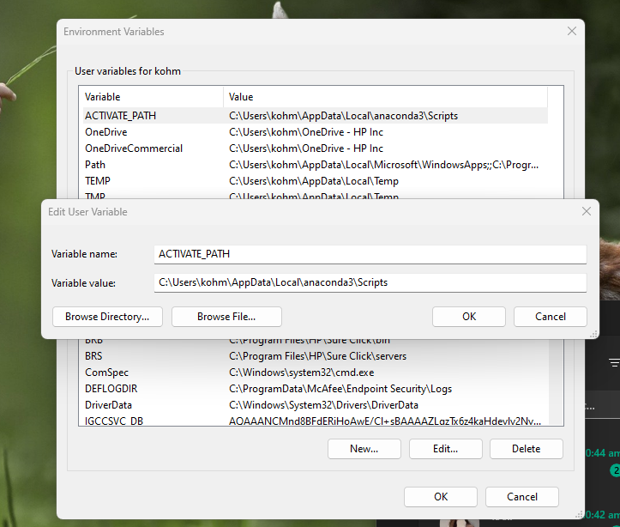
Installing program (pre-setup)
Install Anaconda
Go to system environment in windows
Click environment variables
Add new variable name ACTIVATE_PATH
Browse directory to user\AppData\Local\anaconda3\Scripts
Click OK

Slide 7
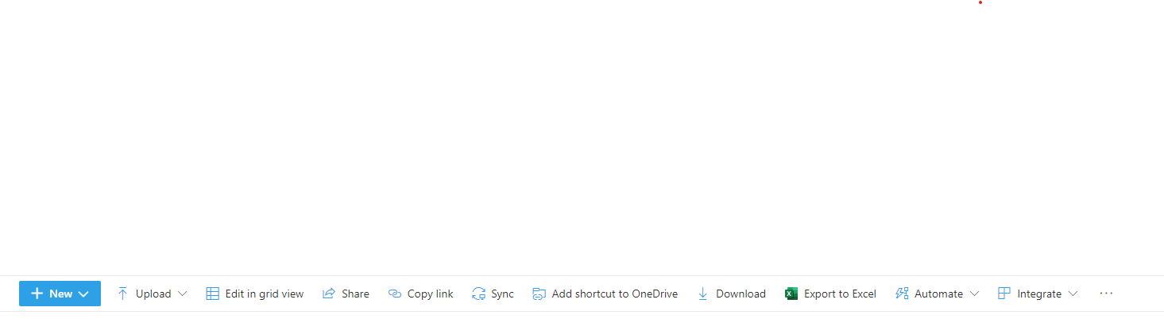
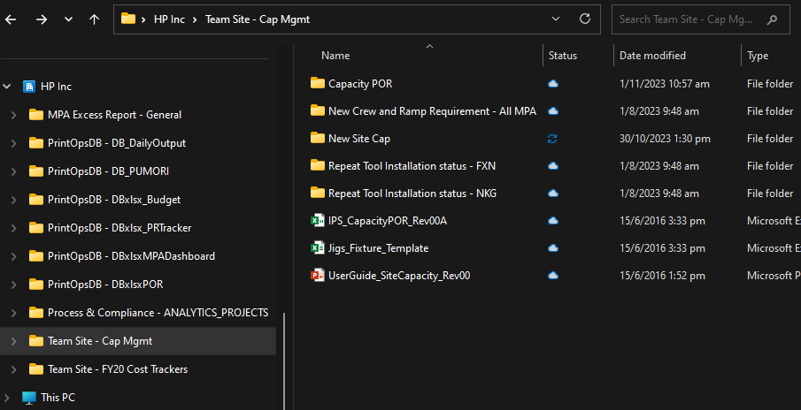
Installing program (pre-setup)
Go to SharePoint and click sync
Team Site – Cap Mgmt should be shown in windows explorer
Open anaconda prompt and enter following commands
Cd C:\Users\kohm\HP Inc\Team Site - Cap Mgmt\New Site Cap\Code
Conda env update --file SiteCap.yml

Slide 8
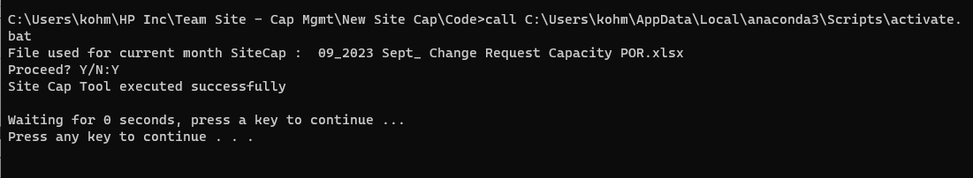
Sitecap Program (Steps to run)
Copy monthly change request sent by planners to SharePoint
Ensure excel sheet name for summary is named Summary Comments
Ensure excel sheet name for change request is in format mmm’yy Change Request (E.g. Sep’23 Change Request)
Column naming and ordering (Last Modified, FY’21, PL, PRODUCT, PLATFORM, TOOLING CAP FY__, MPA, Factory, Capacity Type)
Go to SharePoint and run SiteCap.bat
Ensure file used is correct and press Y followed by enter
Program should show Site Cap Tool executed successfully
Refresh PowerBI and run refresh on PowerApps

Slide 9
Sitecap Sharepoint site
Site Cap SharePoint Site

Slide 10
Program process flow
IPS Capacity POR.csv will be updated in SharePoint(File for PowerBI only)
Comments will be updated if there are any changes in SharePoint (File for PowerBI only)
IPS Capacity for the month (All MPAs) will be output in SharePoint
IPS Capacity for the month (Individual MPA) will be output in SharePoint
SiteCap Tool executed successfully

Slide 11
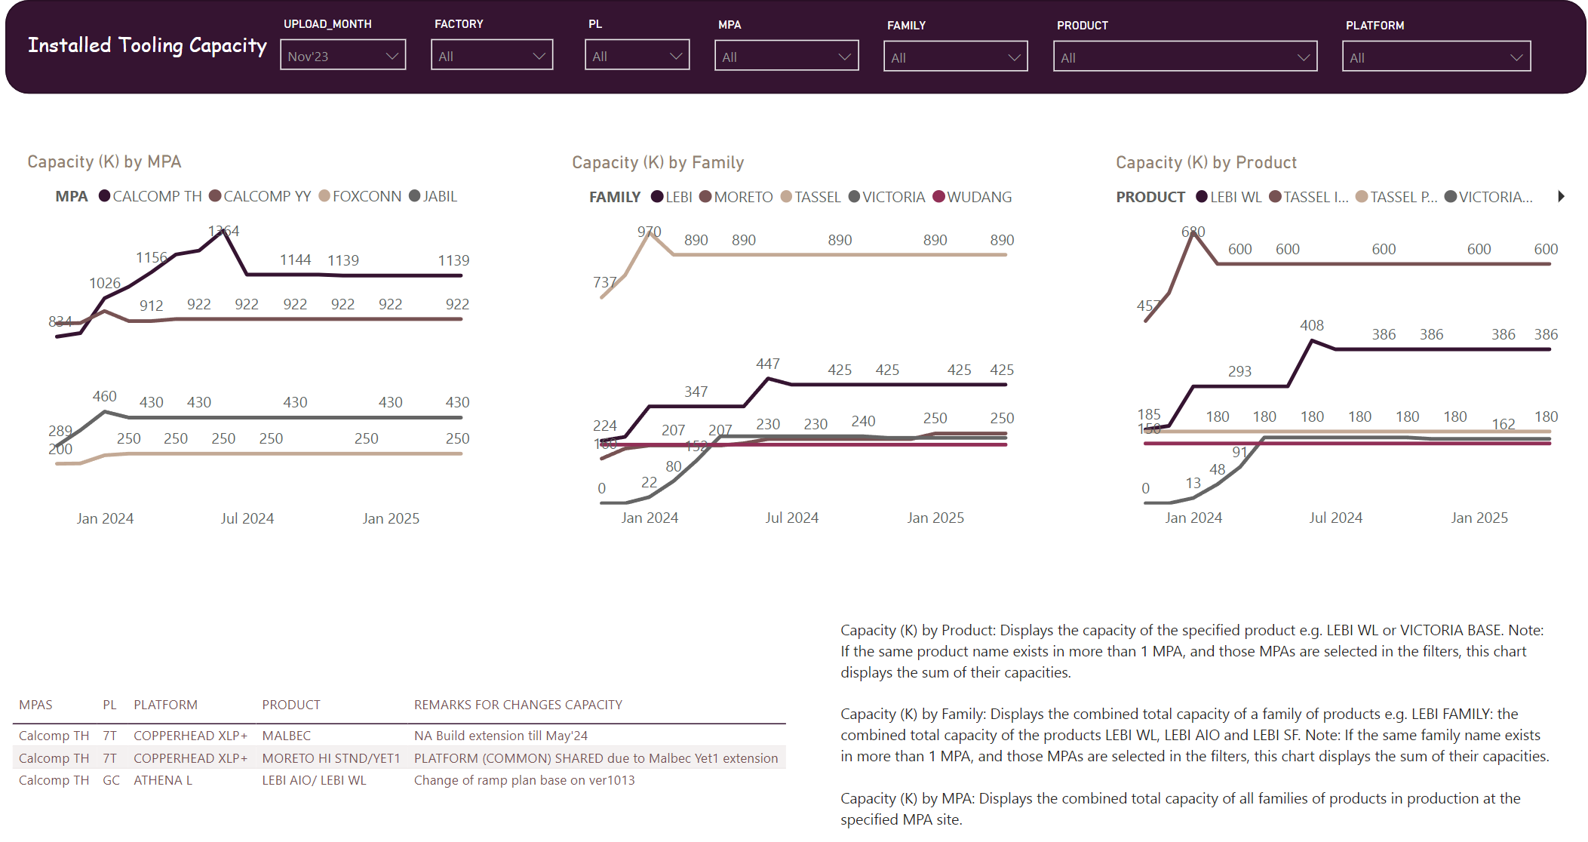
Sitecap Powerbi
Site Capacity

Slide 12
Responsible Accountable Consulted Informed
Sequence of Project Activities | R | A | C | I
1. Request Submittal /Entries /Prioritization | BR | BR | D | D | DM | BRM
2. Objective/Intent Briefing | BR | D |  |  | DM | BRM
3. Review and Analyst Assignment *Based on DT Project Prioritization and Assignment Framework | D | DM | BR | BR |  | BRM
4. Kick Off Meeting | D | D | BR | BR | DM | BRM
5. Investigation Phase *Technical/Project Complexity | D | D | BR | BR | DM | BRM
6. Development Phase | D | D | BR | BR | DM | BRM
7. UAT Phase | BR | D |  |  | DM | BRM
8. Sign off (Go Live) Phase *Based on Aligned Objectives in Point 2. | D | BR |  |  | DM | BRM
9. Business Communication and Activities Post Sign Off Phase *Custodian of Data Source Integrity and Uploads *Knowledge Transfer for BCP | BR | BR | D | D | DM | BRM
10. Maintenance/Support Post Sign Off Phase *Technical Incidents | D | D | BR | BR | DM | BRM
BR = Business Requestor
D = Data Analytic
BRM = Business Requestor's Manager
DM = Data Analytics' Manager

Slide 13
Site Capacity
Backup Slides

Slide 14
Monthly report
Data:
How much capacity per month by factory
Change history

Slide 15
PREVIOUS PROCESS (No change scenario)
July example
1 ) Make a copy of June file and name it to July Open July file IPS Capacity POR_Jul'23
Rename sheet Jun’23 to Jul’23
Select all fonts which is red & bold to black and unbold
2) Send email out to respective stakeholders
Include text updates from MPA leads
Filter column H and upload to respective MPA’s SharePoint
Save June file to July file

Slide 16
previous PROCESS (Change capacity scenario)
May example
1 ) Make a copy of April file and name it to May IPS Capacity POR_May’23
2) Open Change Request Capacity POR for May’23 sent by planners
05_2023 May_ Change Request Capacity POR
Rename sheet Apr’23 to May’23 (Make a copy for May)
Select all fonts which is red & bold to black and unbold
3) Send out email to respective stakeholders
Include text updates from MPA leads
Filter column H and upload to respective MPA’s SharePoint
Copy Summary Comments from May Change Request Capacity POR to IPS Capacity May
See changes in May Change Request Capacity POR and replace in IPS Capacity POR file (Highlight in bold and red for columns A, F, G and monthly data) (Last Modified, Tooling Cap FY and monthly data)
Highlight yellow when PLATFORM (COMMON SHARED IS LESS THAN COMBINED PLATFORM CAPACITY)

